Slide 1
Organization and Architecture, Structure & Function, Brief History of computers.

Slide 2
Why COA
COA basically gives us a very fundamental understanding of how things works in computers..

Slide 3
Definitions..
Computer Architecture – is the abstract model & are those attributes which are visible to programmer like instruction sets, no of bits used for data addressing techniques.
i.e. abstract, programmer view.
Computer Organization – expresses the realization of the architecture like ALU, CPU, memory & memory organization.
i.e. physical & visible

Slide 4
Example
1.Suppose you are in company that manufactures cars, design & all low level details of the car come under computer architecture, while making its part piece by piece & connecting together the different components of that car by keeping the basic design in mind comes under computer organization.

Slide 5
Example
2.Both Intel & AMD processors have the same x86 architecture, but how the two companies implement that architecture is usually very different. The same program runs on both because the architecture is same but they may run at different speeds because the organization are different.

Slide 6
Computer organization and architecture
Computer architecture refers to those attributes of a system visible to a programmer or put another way, those attributes that have direct impact on the logical execution of a program.
Architectural attributes: Instruction sets, Bits used to represent data, I/O Mechanisms
Computer organization refers to the operational units and their interconnections that realize the architectural specification.
Organizational Attributes: Control signals, memory technology, Interfaces between computer and peripherals.

Slide 7
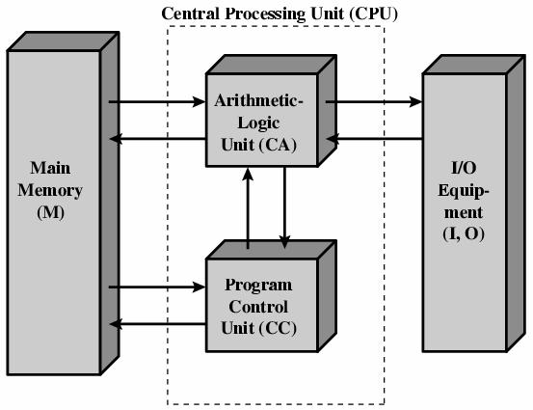
Cont..
Computer organization refers to the operational units and their interconnection that realize the architecture specification.

Slide 8
Cont..
In computer engineering, computer architecture is a set of rules and methods that describe the functionality, organization, and implementation of computer systems.
Some definitions of architecture define it as describing the capabilities and programming model of a computer but not a particular implementation.

Slide 9
Structure and function
Computer is a complex system.
At each level of hierarchy, designer is concerned with structure and function.
Structure is the way in which components are interrelated to each other
Function is the operation of individual components as part of the structure
We have two choices – bottom to top
- top to bottom
Notes:
Millians of electronic components are in computer. Represent in hierarchical manner,
At each level different set of components -> interrelate to each other.
At each level, designer is concerned with structure and function.

Slide 10
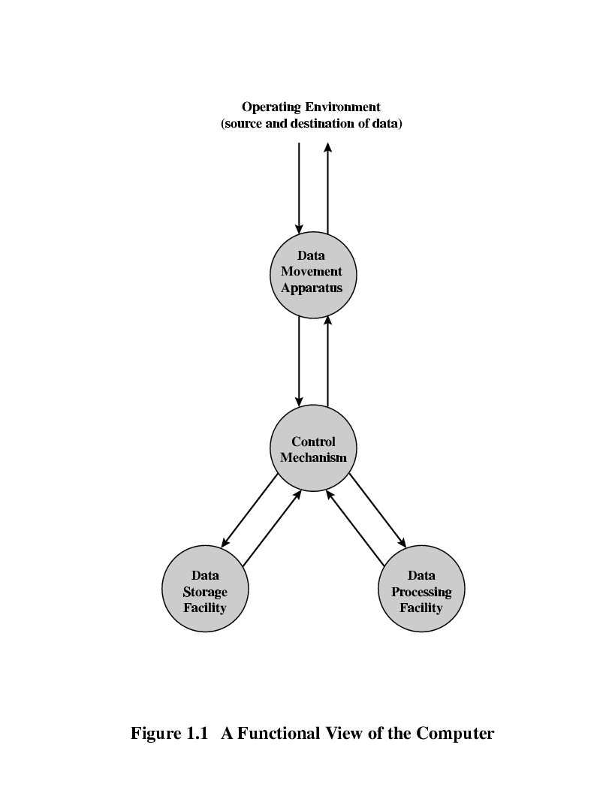
Function
Computer functions are:
Data processing
Data storage
Data movement
Control Mechanism

Slide 11
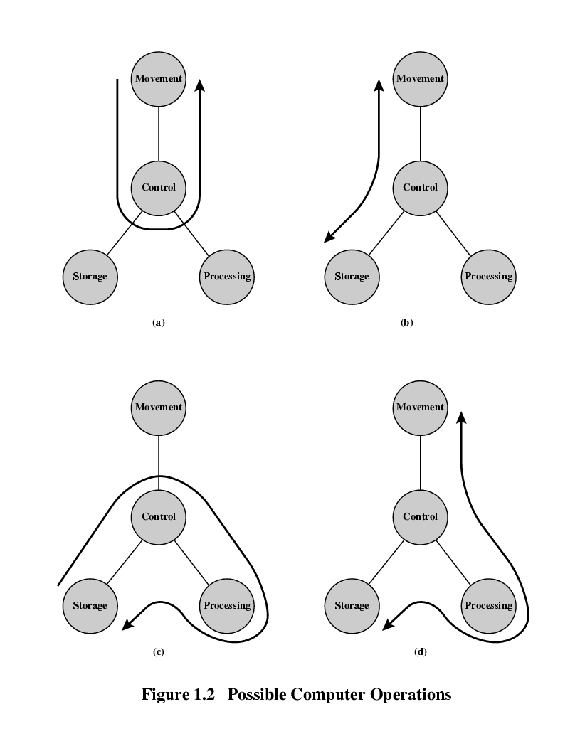
Operation: Data Processing from/to storage
Data Processing:
The data may take wide variety of forms.
Fundamental methods or type of data processing.
Notes:
Basic function that computer can perform

Slide 12
Operations: Data Storage
Data Storage:
Short term data storage function(processing data on the fly)
Temporary store of data
Long term data storage function
Files

Slide 13
Operations : Data movement
Data Movement:
Computer able to move data between itself and the outside world.
Computer can function as data movement device, simply transferring data from one peripheral or communication line to another.

Slide 14
Operations : Data movement
When data are received from or delivered to a device that is directly connected to the computer, the process is known as input output(I/O) and device is referred to as peripherals.
When data are moved over longer distances to or from a remote device the process is known as data communications.

Slide 15
Operation: Control
Data Control:
Within a computer, Control unit manages the computer resources and functions.
Provide instructions.

Slide 16
Structure
The Computer
CPU
Controls the operation of the computer and performs its data processing functions.
Main memory
Stores data
I/O
Moves data between the computer and its external environment
System interconnection
Provides for communication among CPU, main memory, and I/O

Slide 17
Structure - Top Level
Peripherals
Computer
Central
Processing
Unit
Main
Memory
Computer
Systems
Interconnection
Input
Output
Communication
lines

Slide 18
Structure - The CPU
CPU
Computer
Arithmetic
and
Logic Unit
I/O
Registers
System
Bus
CPU
Internal CPU
Interconnection
Memory
Control
Unit

Slide 19
Structure - The CPU
Control unit: Control the operation of CPU and hence the computer.
Arithmetic and logic unit(ALU): Performs computers data processing function.
Registers: Provides storage internal to the CPU
CPU Interconnection: some mechanisms that provide for communication among the control unit, ALU and registers

Slide 20
Structure - The Control Unit
Control Unit
CPU
ALU
Sequencing
Logic
Internal
Bus
Control
Unit
Control Unit
Registers and
Decoders
Registers
Control
Memory

Slide 21
Evolution (a brief history) of computers
Microchip
Integrated Circuit
Transistor
Vacuum Tube

Slide 22
First Generation: Vacuum Tubes
ENIAC(Electronic Numerical Integrator and computer) : World’s first general purpose electronic digital computer.
ENIAC was a decimal rather than a binary machine.
Memory consist of 20 accumulators(Each one hold 10 digit decimal no.)
A ring of 10 vacuum tubes represented each digit.
Task of entering and altering programs for ENIAC was extremely tedious.
Notes:
Numbers represented in decimal form….arithmetic was performed on decimal system.

Slide 23

Vacuum Tubes - 1941 - 1956
First Generation Electronic Computers used Vacuum Tubes
Vacuum tubes are glass tubes with circuits inside.
Vacuum tubes have no air inside of them, which protects the circuitry.

Slide 24
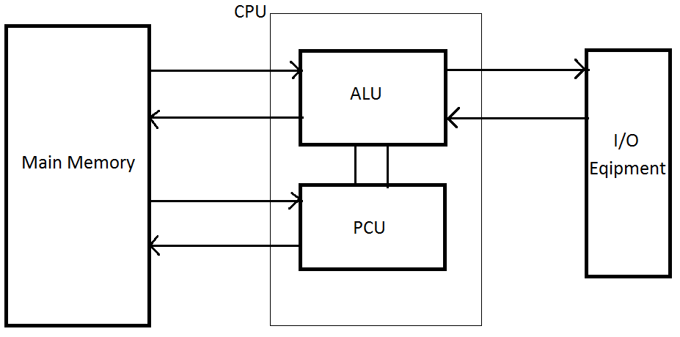
First Generation: Vacuum Tubes
In 1946, John von Neumann and his colleagues began to design of new stored computer, referred to as IAS Computer.

Slide 25
First Generation: Vacuum Tubes
Main Memory: Stores both data and instructions
ALU: Capable of operating on binary data
PCU: Interprets the instructions in memory and causes them to be executed.
I/O Equipment: Operated by control unit
CPU: Fetching instructions from memory and executing them one at a time.

Slide 26
First Generation: Vacuum Tubes
Memory of IAS consist of 1000 storage locations(words) of 40 binary digits(bits) each.
Both data and instruction stored there.
Hence numbers must be represented in binary form and each instruction also has to be a binary code.

Slide 27
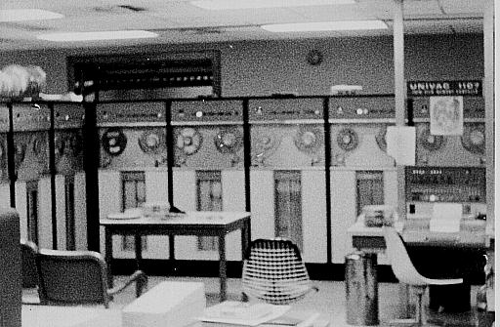
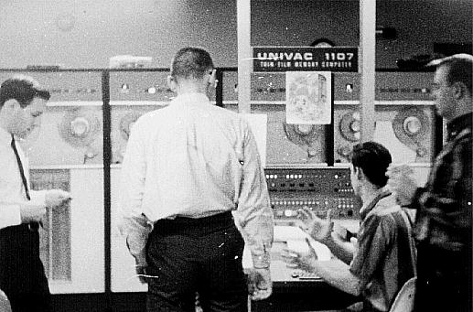
UNIVAC - 1951
UNIVAC(Universal Automatic Computer)
First fully electronic digital computer built in the U.S.
UNIVAC weighed 30 tons
contained 18,000 vacuum tubes
Cost a paltry $487,000

Slide 28
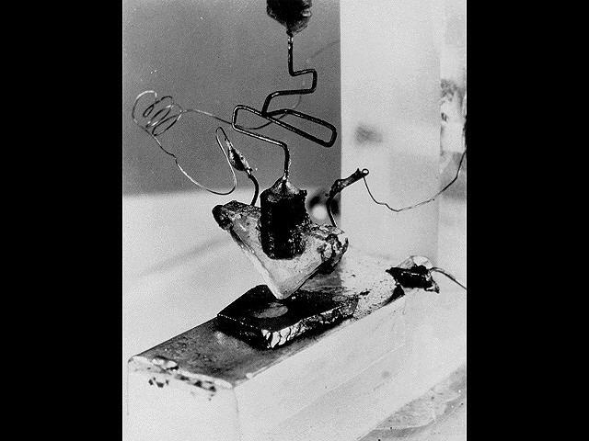
First Transistor
Uses Silicon
developed in 1948
Won a Nobel prize
on-off switch
Second Generation Computers used Transistors, starting in 1956

Slide 29
Second Generation: Transistors
1956 – Computers began to incorporate Transistors
In Electronic computer, vacuum tube replaced with transistor(smaller, cheaper and dissipates less heat than vacuum tube).
Each new generation is characterized by greater processing power, large memory capacity and smaller size than previous one.
Introduction of more complex arithmetic and logic units and control units.
Use of high level programming languages.
Notes:
Use same way as vaccum tube to construct computer.

Slide 30
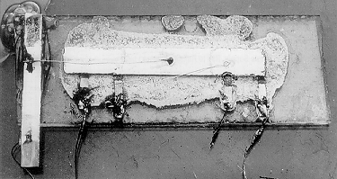
Third Generation: Integrated Circuits
Third Generation Computers used Integrated Circuits (chips).
Integrated Circuits are transistors, resistors, and capacitors integrated together into a single “chip”

Slide 31
Third Generation: Integrated Circuits
1964-1971
Software – Instructions for Computer
Operating system is set of instructions loaded each time a computer is started.
Program is instructions loaded when needed.
Integrated Circuit
Getting smaller, cheaper

Slide 32
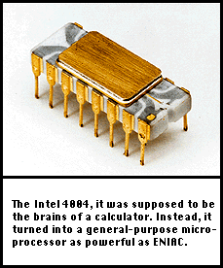
The First Microprocessor – 1971
Intel 4004 Microprocessor
The 4004 had 2,250 transistors
four-bit chunks (four 1’s or 0’)
Called “Microchip”

Slide 33
What is a Microchip?
Very Large Scale Integrated Circuit (VLSIC)
Transistors, resistors, and capacitors
4004 had 2,250 transistors
Pentium IV has 42 MILLION transistors
Each transistor 0.13 microns

Slide 34
4th Generation – 1971-present
MICROCHIPS!
Getting smaller and smaller, but we are still using microchip technology.

Slide 35
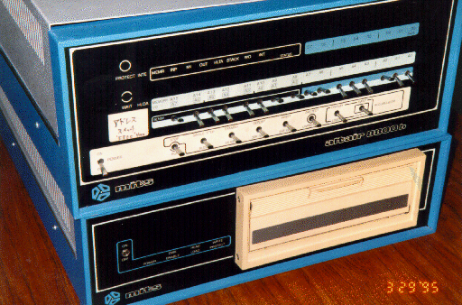
Birth of Personal Computers - 1975
256 byte memory
2 MHz Intel 8080 chips
Just a box with flashing lights
cost $395 kit, $495 assembled.

Slide 36
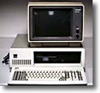
IBM PC - 1981
IBM-Intel-Microsoft
First wide-selling personal computer used in business
8088 Microchip - 29,000 transistors
4.77 Mhz processing speed
256 K RAM (Random Access Memory) standard
One or two floppy disk drives

Slide 37
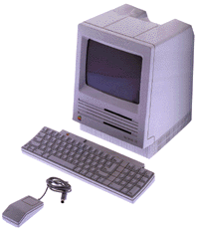
Apple Computers
Founded 1977
Apple II released 1977
widely used in schools
Macintosh
released in 1984, Motorola 68000 Microchip processor
first commercial computer with graphical user interface (GUI) and pointing device (mouse)

Slide 38
Computers Progress

Slide 39
1990s: Pentiums and Power Macs
Early 1990s began penetration of computers into every niche: every desk, most homes, etc.
Faster, less expensive computers paved way for this
Windows 95 was first decent GUI for “PCs”
Macs became more PC compatible - easy file transfers
Prices have plummeted
$2000 for entry level to $500
$6000 for top of line to $1500

Slide 40
21st Century Computing
Great increases in speed, storage, and memory
Increased networking, speed in Internet
Widespread use of CD-RW
Cell Phone
WIRELESS!!!

Slide 41
Interconnection Structures
A computer consists of a set of components (CPU,memory,I/O) that communicate with each other.
The collection of paths connecting the various modules is call the interconnection structure.
The design of this structure will depend on the exchange that must be made between modules.

Slide 42
Memory for each module
Read
Memory
N Word
0
.
.
.
N-1
Write
Data
Address
Data

Slide 43
CPU
CPU
Instructions
Data
Interrupt Signal
Control
Signal
Data

Slide 44
I/O module
Read
I/O Module
M Ports
Write
Internal Data
Address
External Data
Internal Data
External Data
Interrupt Signal

Slide 45
Type of transfers
Memory to CPU
CPU to Memory
I/O to CPU
CPU to I/O
I/O to or from Memory (DMA)

Slide 46
Bus Interconnection
A bus is a communication pathway connecting two or more device.
A key characteristic of a bus is that it is a shared transmission medium.
A bus consists of multiple pathways or lines.
Each line is capable of transmitting signal representing binary digit (1 or 0)

Slide 47
Bus Interconnection
A sequence of bits can be transmit across a single line.
Several lines can be used to transmit bits simultaneously (in parallel).
A bus that connects major components (CPU,Memory,I/O) is called System Bus.
The most common computer interconnection structures are based on the use of one or more system buses.

Slide 48
Bus Structure
A system bus consists of 50-100 lines.
Each line is assigned a particular meaning or function.
On any bus the lines can be classified into 3 groups
Data lines
Address lines
Control lines

Slide 49
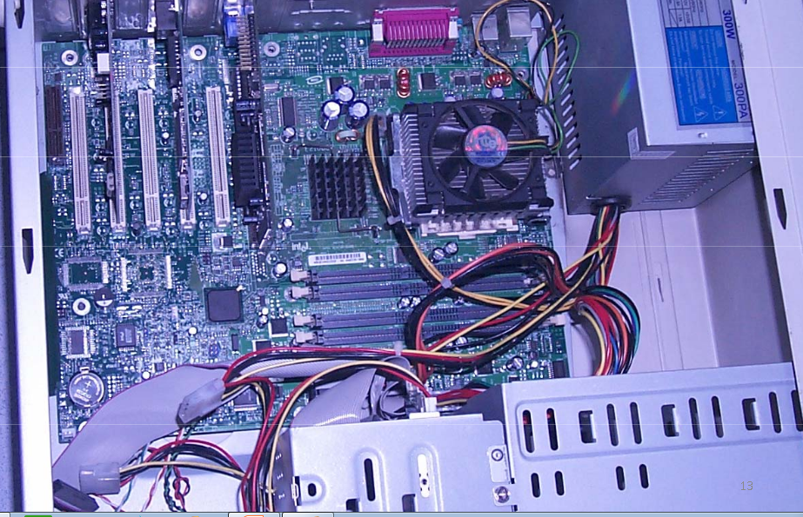

Slide 50
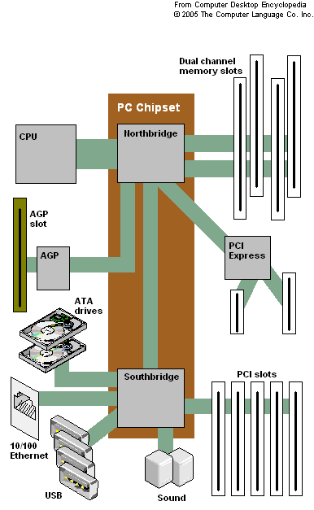
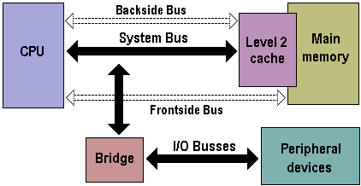

Slide 51
